Slide 1
Comic Relief:
Educate, Enable, Empower
Soroptimist International Conference 2013
2nd November 2013
08.45AM

Slide 2
What’s Happened in 25 years at Comic Relief?
We’ve so far raised over £900m and helped to change millions of lives as a result.
Comic Relief cash has been at work in over 70 countries around the world since it began in 1985.
Comic Relief supports work in the UK as well as overseas and has funded 15,786 projects in the UK to date and many hundreds internationally.
Contrary to popular belief, we work all year round, fighting poverty and social injustice in the UK and across the world.

Slide 3
What is Comic Relief?
Our mission is to drive positive change through the power of entertainment.
Since we first set up shop in 1985, we’ve been doing three main things…
We raise millions of pounds through two big fundraising campaigns – Red Nose Day and Sport Relief.
We spend that money in the best possible way to tackle the root causes of poverty and social injustice.
We use the power of our brand to raise awareness of the issues that we care most about.

Slide 4
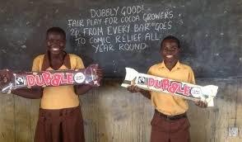
Positive change through the power of entertainment
Click

Slide 5
What Happened in 25 years for African Women?
70% of the world’s poorest people are women
Women own only 1% of the world’s property
55% of those not enrolled in school are girls
66% of illiterate people are women
Domestic violence is the largest cause of women’s injury and death, leading to more deaths and disability among women aged 15-44 than malaria, war, traffic accidents, and cancer. It is estimated that 1 in 3 women in Africa experiences violence in the home
The World Health Organisation (WHO) estimates that female genital mutilation (FGM) has affected as many as 138 million women and girls in Africa, and the numbers continue to rise at a rate of approximately 2 million per year
27% of girls aged 15-19 in sub Saharan Africa have been married
28% of girls have given birth by age 18

Slide 7
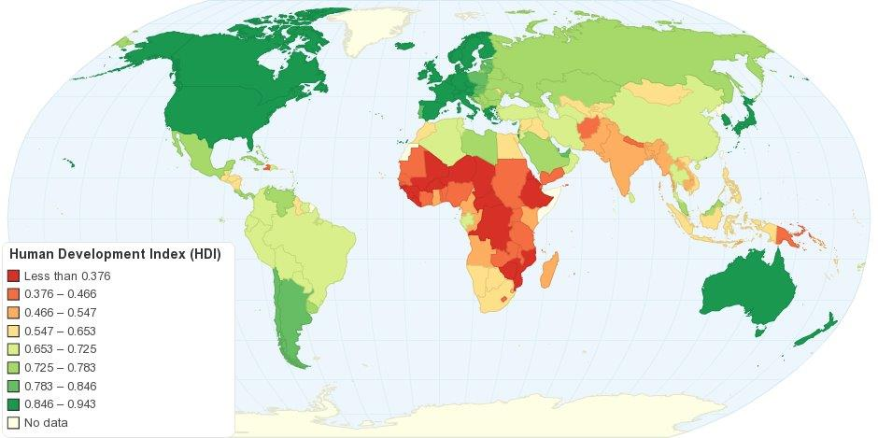

Slide 9
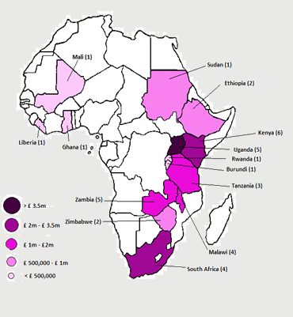
Some of the things that Comic Relief’s Women and Girls Programme Has Supported

Slide 13
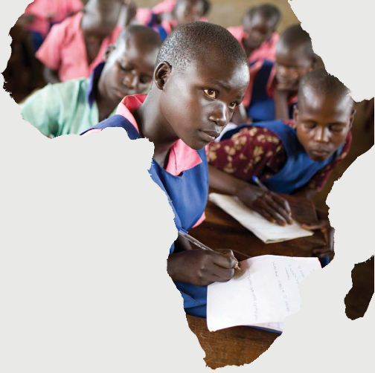
DISADVANTAGED CHILDREN AND ADULTS GAIN ACCESS TO AND ATTAIN A GOOD QUALITY EDUCATION

Slide 14
Educate to Empower
The average sub-Saharan African girl from a low-income, rural household gets less than two years of schooling and never learns to read and write, to add and subtract, as opposed to the average sub-Saharan African boy who fully completes primary education.
Worldwide, girls constitute over half of the children out of school.
Only 30 per cent of all girls are enrolled in secondary school.
In many countries, less than one third of university students are women.

Slide 15
Empower to Lead
Children born to educated mothers are two times more likely to survive past the age of 5.
Education drastically reduces child marriage. On average, a girl with 7 years of education will marry 4 years later and have 2.2 fewer children.
A girl who completes basic education is three times less likely to contract HIV.
Knowledge and skills learned at school will be passed onto her parents and the community.
Education empowers girls by introducing new ways of thinking about traditions and issues, and challenges traditionally held gender roles.
Education helps a girl to respect herself and to be respected by others.
Education is essential for a strong economy. One extra year of school boosts a girl’s future wages by 10-20 per cent.

Slide 16
Empower to Lead cont.
Education fosters critical thinking skills, which are essential for effective leaders and democracy.
More women are needed to solve global problems.

Slide 17
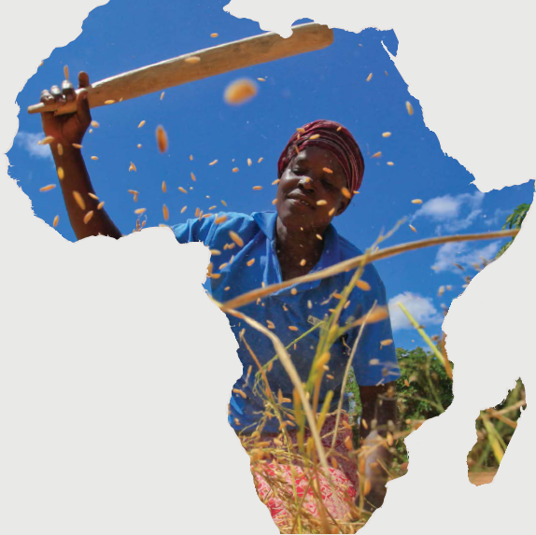
WOMEN AND GIRLS ARE EQUAL AND RESPECTED MEMBERS OF SOCIETY

Slide 18
Uphill all the way
Women’s rights organizations get very little support for their work…
“….women’s rights organizations, networks and movements are drastically underfunded, making up less than 10% of philanthropic giving in both Europe and the United States.”
Notes:
citing data Forbes.com, The Power of Investing in Women, by Betsy Brill, 3/28/11, & “Untapped Potential: European Foundation Funding for Women and Girls”, MamaCash, The Foundation Center and Weisblatt & associé, January 2011

Slide 19
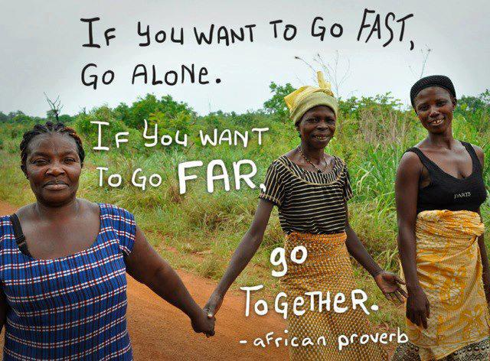

Slide 20
What a little bit of money can buy
 |  | Could pay for text messages to be sent to fifteen young women in the UK who self-harm, providing urgent advice and support when they need it most
 |  | Could pay for 10 children in Uganda to be tested for malaria so they can get a quick diagnosis and receive the life-saving treatment they desperately need
 |  | Could pay for a young carer in the UK to meet a specially trained support worker to help them cope with their responsibilities at home and deal with any other problems they face
 |  | Could provide a child living in poverty in Africa with a pair of glasses so that they can learn to read and write in school.
 |  | Could provide a warm meal at a safe house for a mother and child who have fled domestic abuse in the UK
 |  | Could pay for a check up for a child living on the streets in Uganda to ensure they get the medical help they might need.
£1
£4
£10
£1
£5
£2

Slide 21
If women could move such mountains with so little, what could they do with a 100, with 500, with a billion??
….. They could transform the entire world!

Slide 22
http://www.youtube.com/watch?v=t1zHJTXy4oI

