Slide 1
Programme Action: our reason for being Soroptimists
Sue Biggs
SIGBI Federation Programme Director

Slide 2
Programme
Action

Slide 3
Programme Action Goals
Goal One
Learning opportunities
Economic empowerment
Violence and conflict resolution
Food security and health
Environmental sustainability
Goal Two
Presence as an advocate at all levels
Intensify activities and partnerships to raise profile and visibility

Slide 4

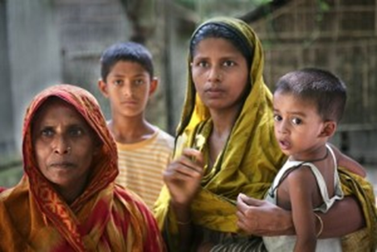
Post 2015 agenda….
Notable progress made
Still much to be done
Depends upon women’s equal access to education, healthcare, work and participation in decision making processes

Slide 5
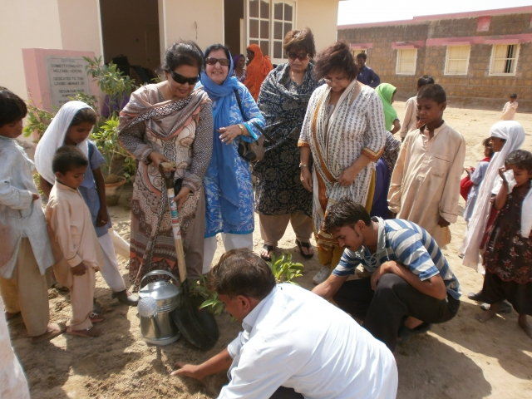
To live free from poverty and hunger….
Biggest challenge for poverty eradication
Rising female economic activity is seen as an indicator of women and girls empowerment
Education and employment are playing a pivotal role

Slide 6
Reaching the health MDGs ….
Reduction in child mortality (MDG4)
Women are still dying from preventable causes
Lack of knowledge
Low education levels
Lack of access to information
Gender based violence
Lack of money and no mobility

Slide 7
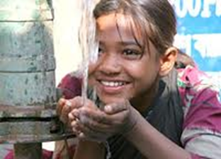
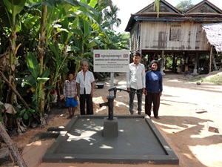
Access to water and sanitation….
In March 2012 the world met the water target
780 million use unimproved sources of drinking water
Lack of sanitation facilities exposes risks of violence
4000 babies die each day from lack of clean water

Slide 8
Lessons learned and priority areas….
Development of school curricula to challenge stereotypes
Support girls’ school attendance, completion and effort
Improve health facilities
Focus attention on human development issues
Not always joined up thinking

Slide 9
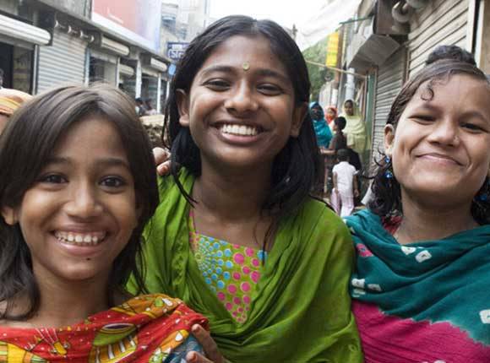
What comes next….
The message is simple. Women who are safe, healthy, educated and fully empowered to realise their potential transform families, their communities, their economics and their societies.

Slide 10
Post 2015 framework….
Gender mainstreaming and a commitment to gender mainstreaming
Strong commitment to human rights
Address all forms of violence against women and girls
Address women’s workloads
Harness women’s knowledge for environmental sustainability
Monitor quality as well as well as quantity

Slide 11
Any questions?

