Slide 1

Soroptimist International Guernsey
‘Orange the World’
Campaign for the elimination of domestic violence

Slide 2
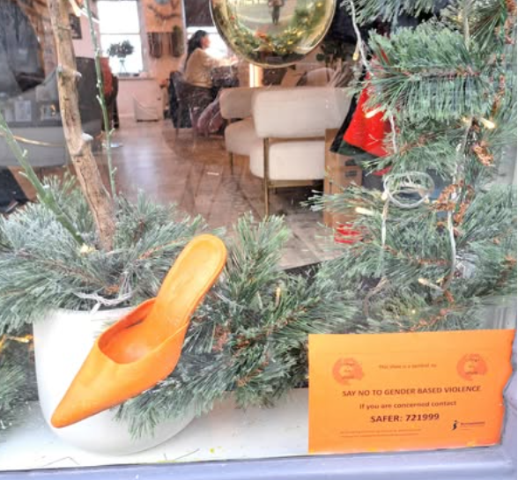
Orange shoes
We worked with local shops, restaurants and offices to place an orange shoe in a prominent place in their windows. They had a card alongside to give information about where to go for help.
This idea attracted a lot attention from the media and our Facebook posts spread around the World. Our ‘Likes and Shares’ increased enormously!

Slide 3
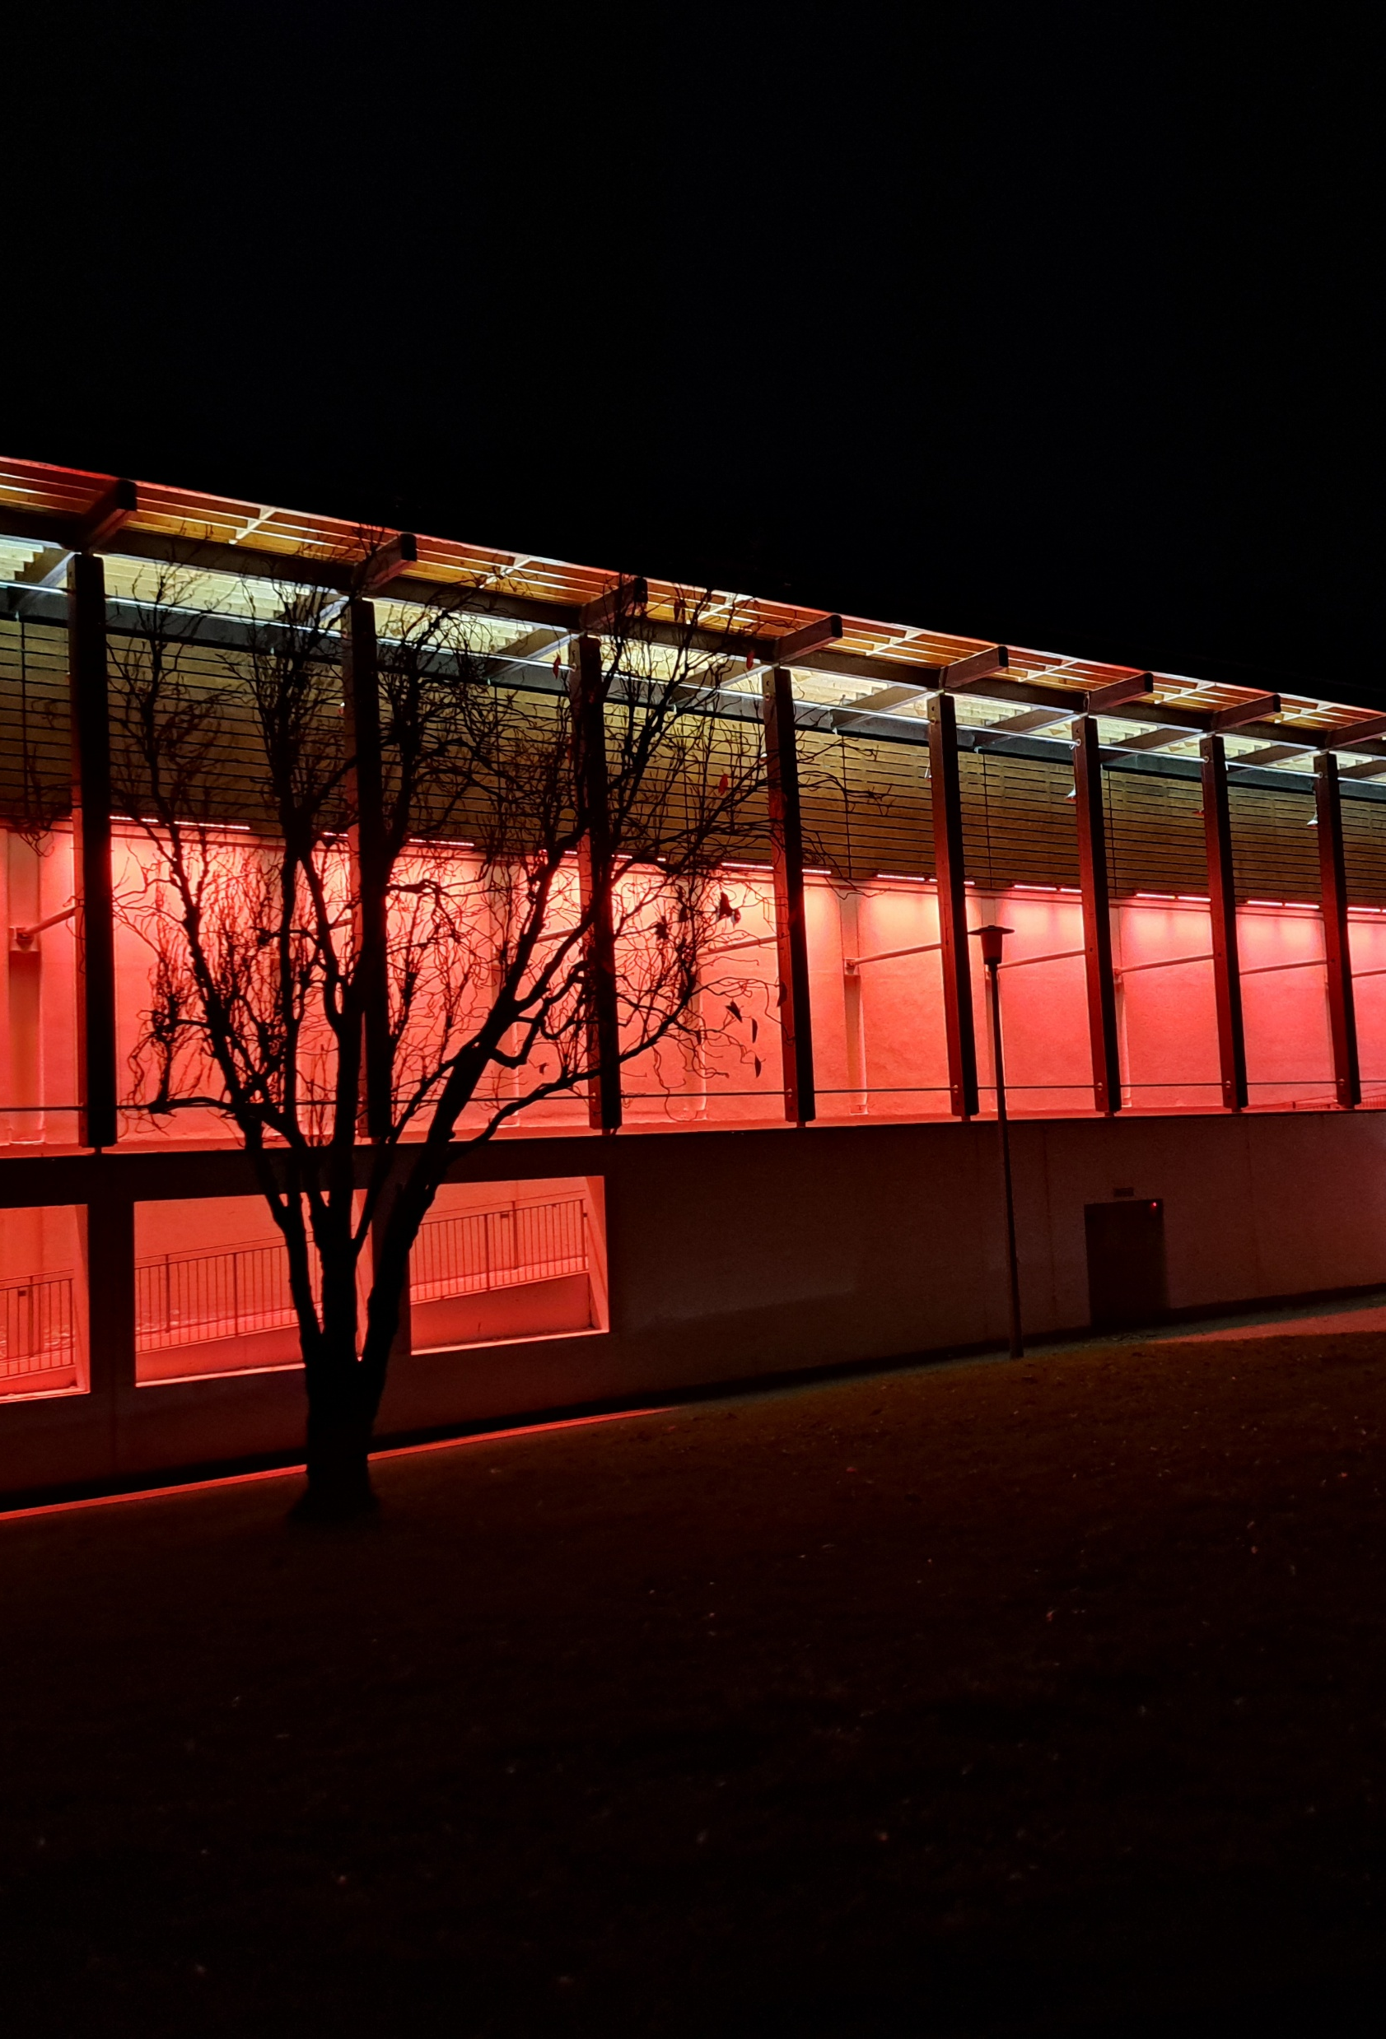
Lighting up buildings in orange
We arranged for several buildings to be lit up in orange or fly an orange flag or display an orange banner on their railings.
These attracted a lot of followers on Social Media.

Slide 4
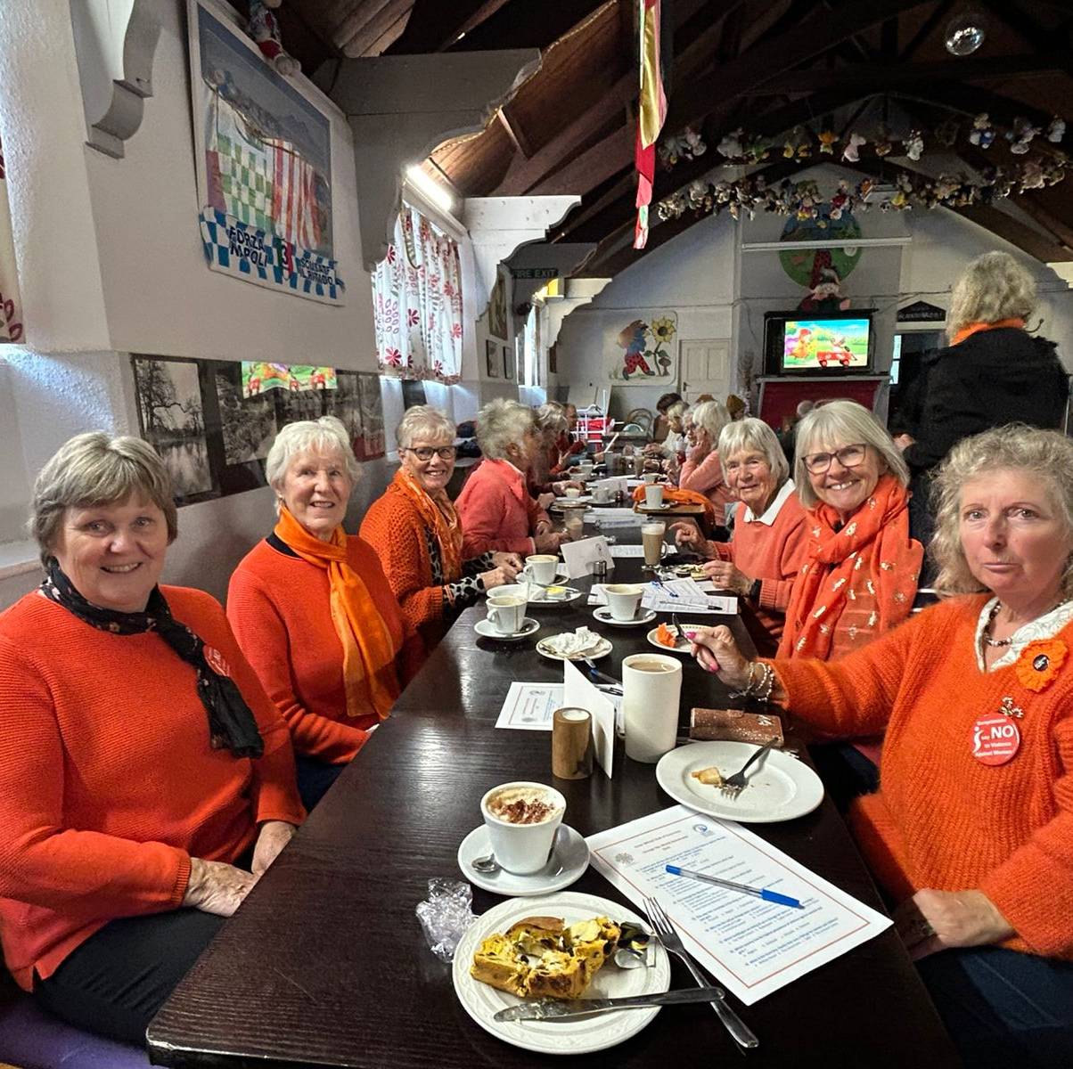
Orange walk with ladies from Inner Wheel
We dressed in orange and walked around a park then had a cuppa in the café.
Good publicity from radio and newspaper.

Slide 5
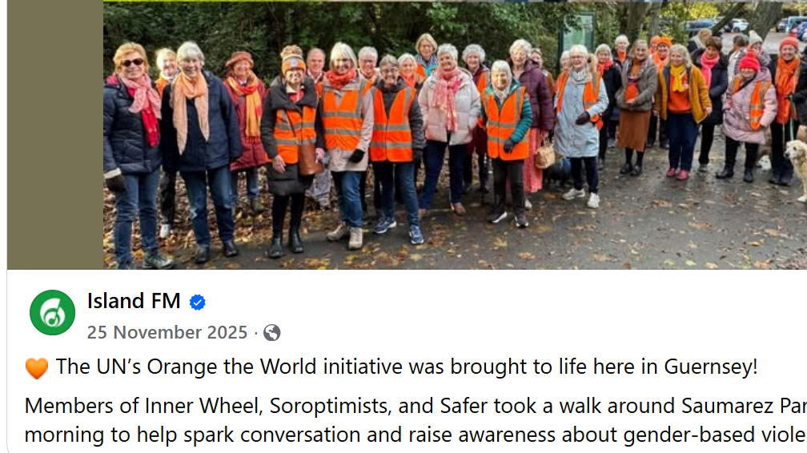

Slide 6
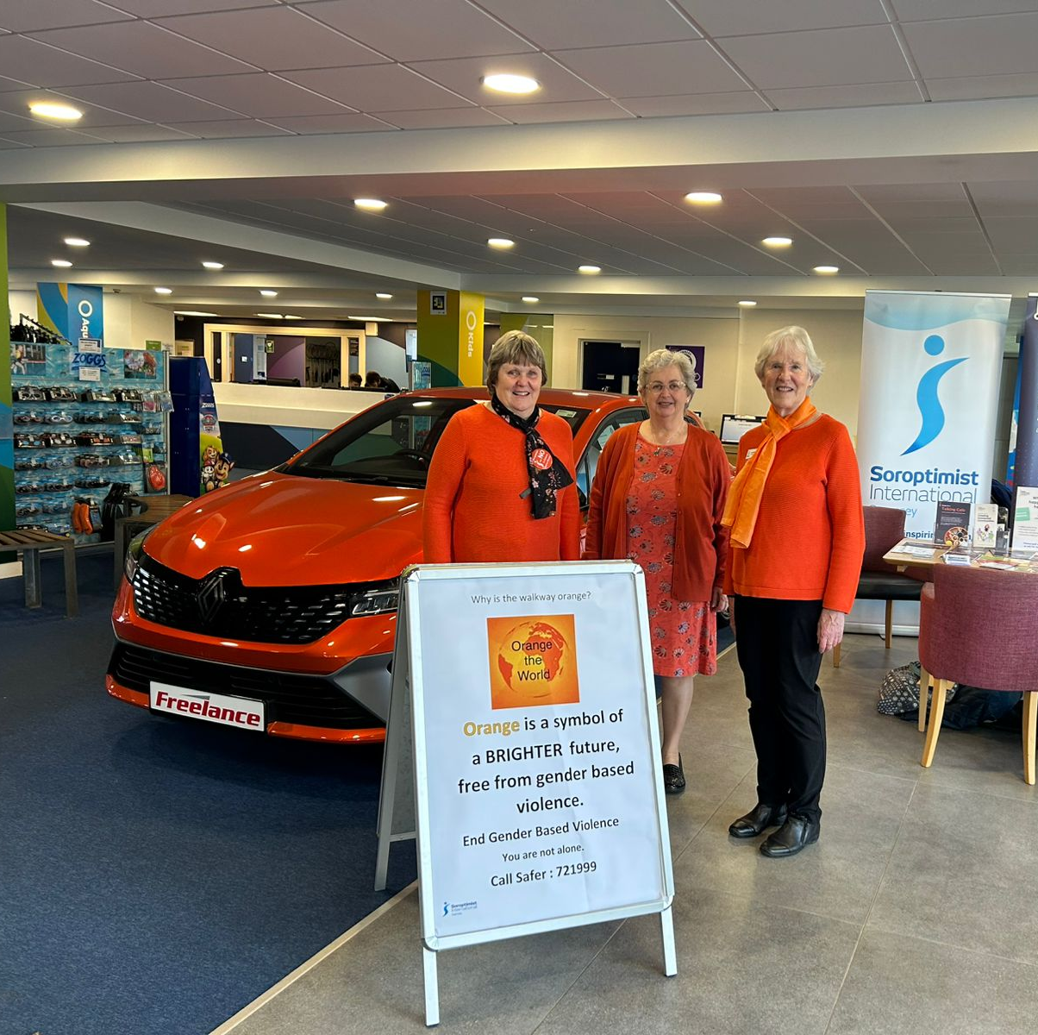
Orange Café
We held an Orange Café with our Health Connections ‘Talking Café’ and other representatives from our Domestic Abuse charity.
A local garage placed an orange car in the venue and this attracted a lot of attention from all media.

Slide 7
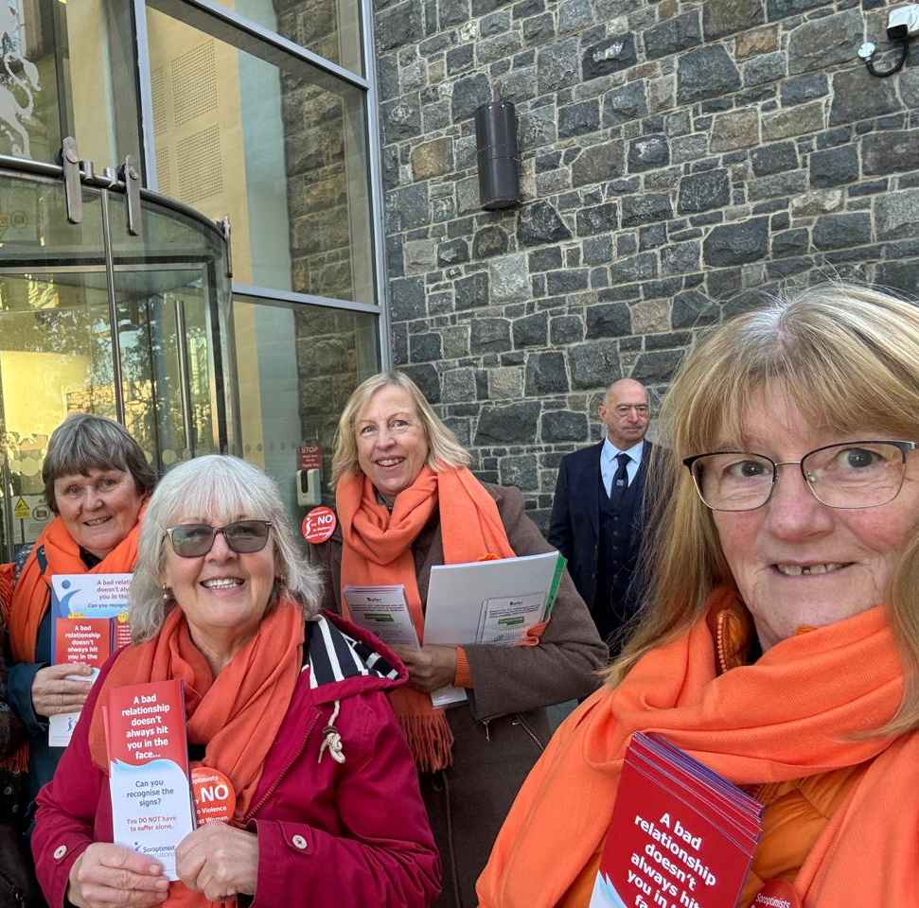
Involving local politicians
Club members dressed in orange and stood outside the building where our Deputies hold their meetings.
Many Deputies supported our campaign by wearing something orange.

Slide 8
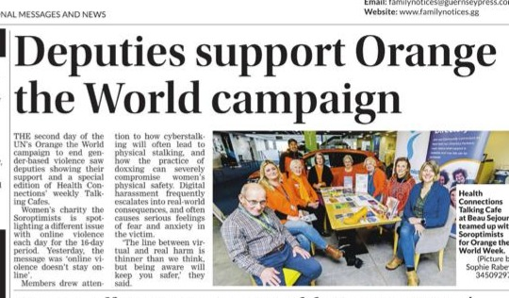

Slide 9
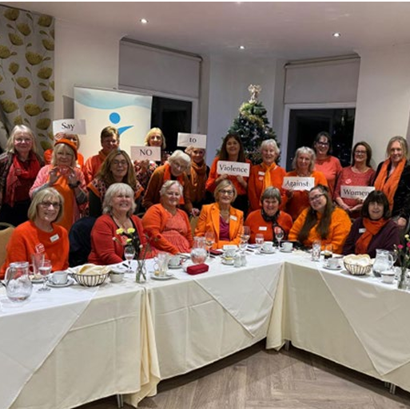
November Business meeting
Club members dressed in orange for our November Business meeting and supper.

Slide 10
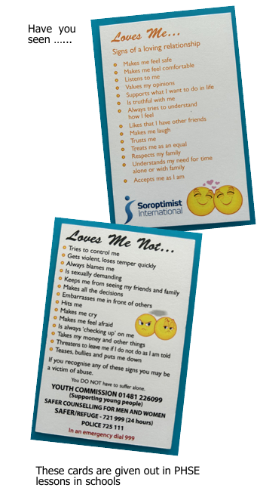
Love Me … Loves Me Not …
We produced these cards and now pay to have them printed. They are given out in PSHE lessons.
We also have leaflets, posters and bookmarks printed with this information. They are given to schools and businesses who display them in their toilets.

