Slide 1
Soroptimists International Jersey
PR Communication Ideas

Slide 2

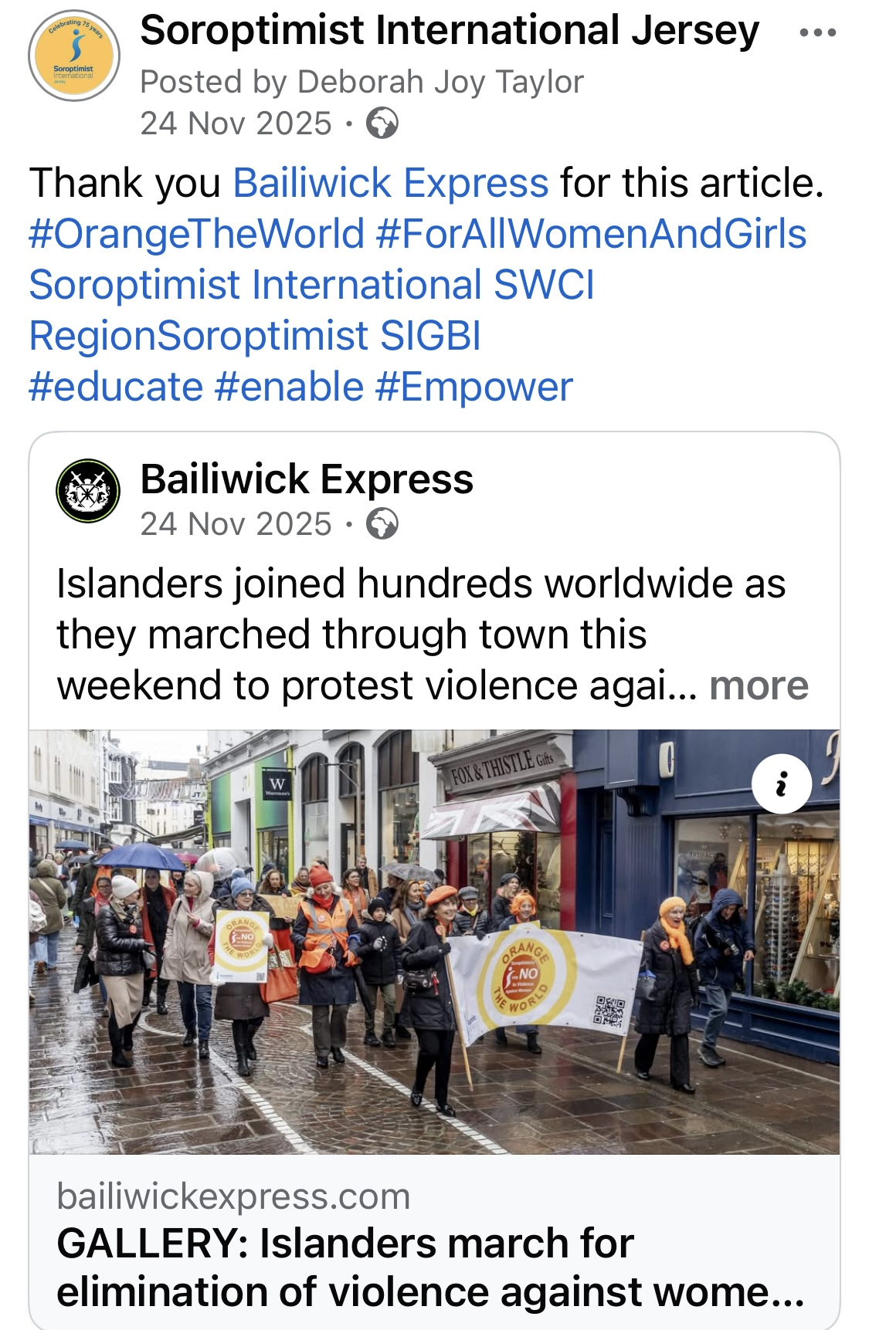
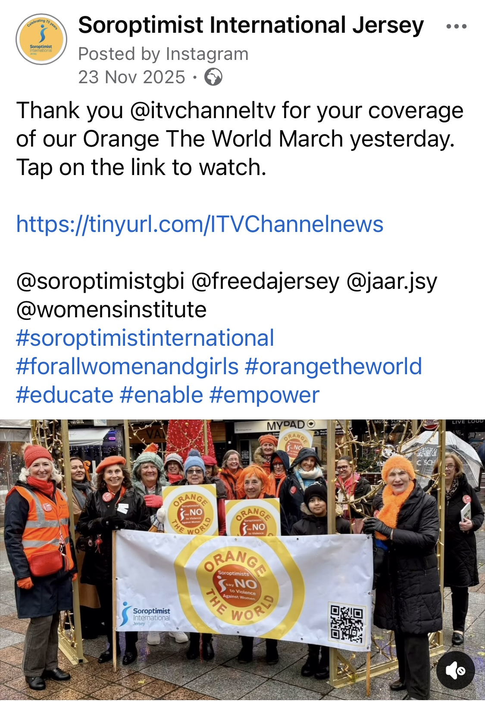
Raising Awareness – 2 examples
Orange the World & Inspirational Woman of the Year
Multi-channel approach
  High intensity posts on social media
  Local radio & TV
  Local press
Make all comms appealing, relevant to local people
Communicate all year – it’s not just about an event

Slide 3

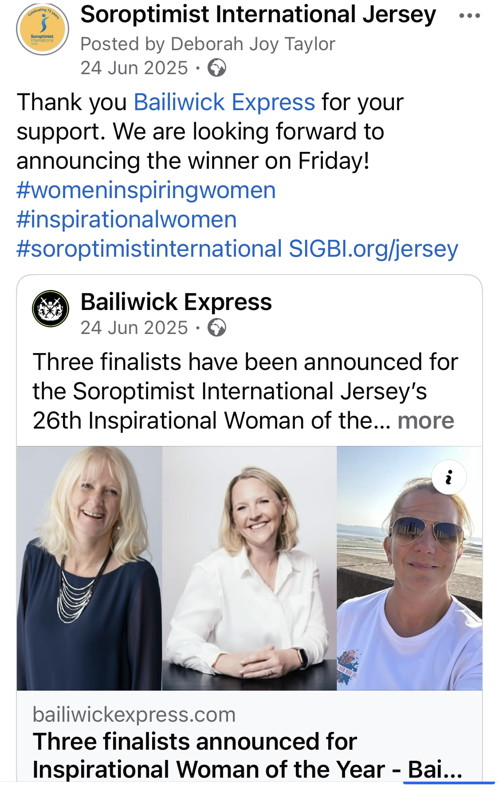
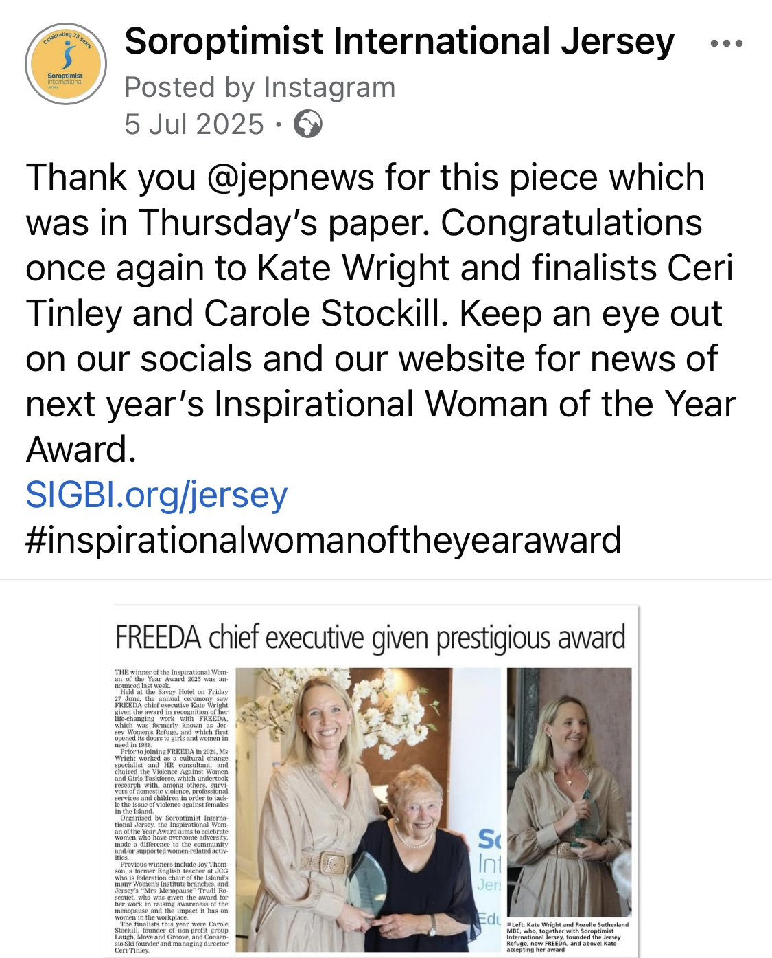
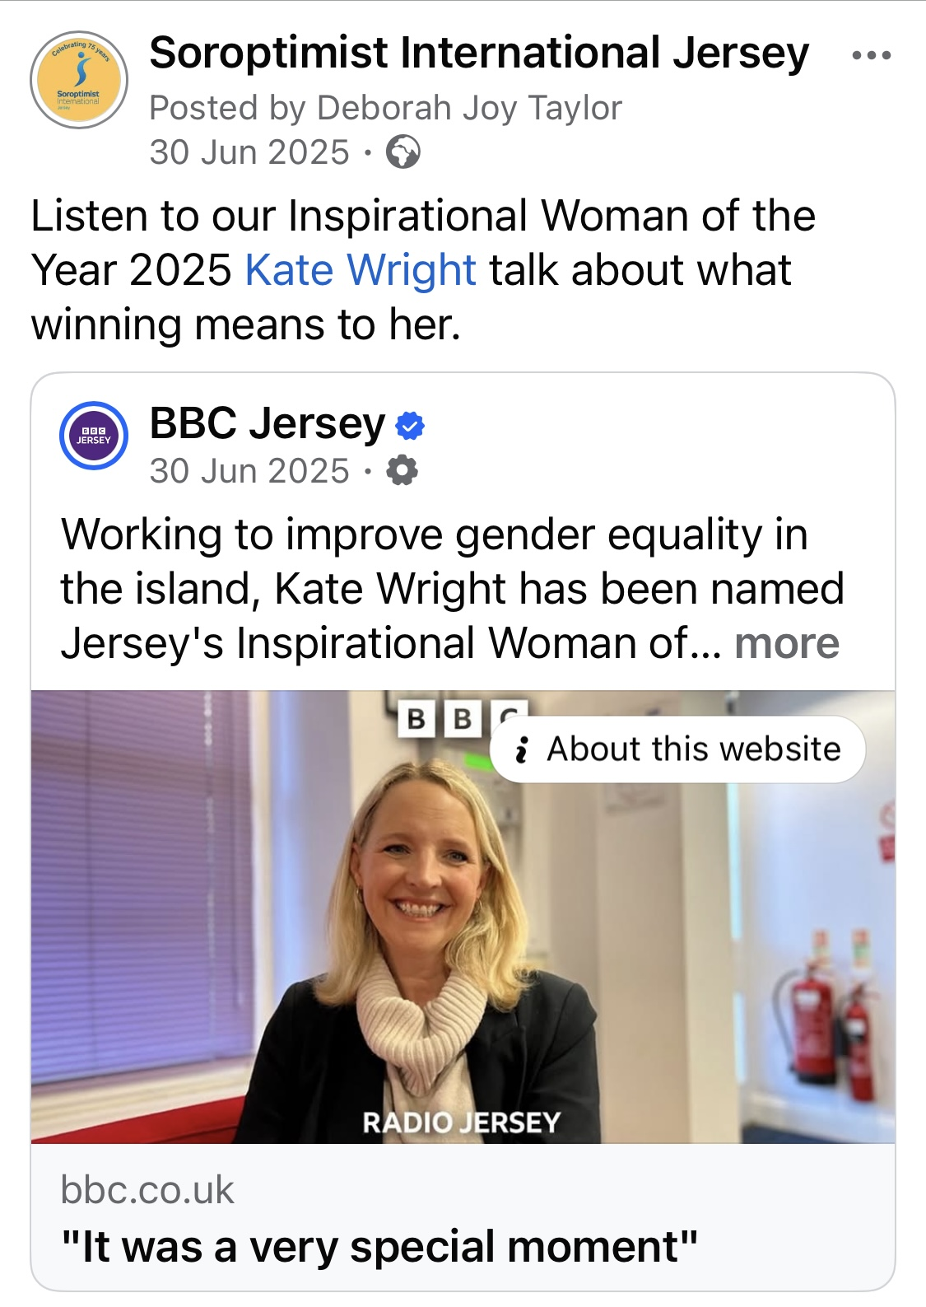
Inspirational Woman of the Year
Direct Social Media
Press
BBC Local Radio

