Slide 1
Our proposed PR for IWD2027
For presentation at the workshop on 28 March 2026

Slide 2
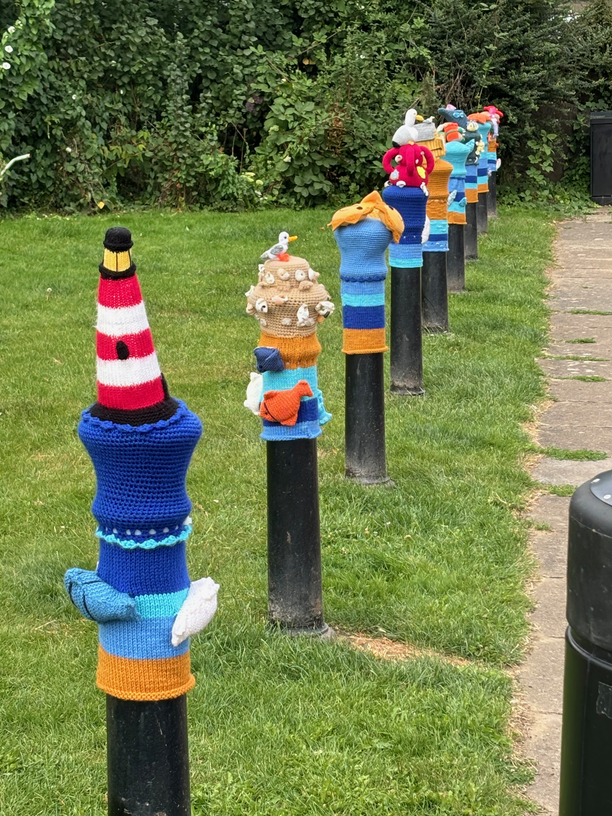
Background:
Solent East club covers quite a large area, without a central focus for activity, so we adopt different ideas for different places
We saw a display a few years ago from the Titchfield Yarnbombers, which sparked an idea…
…bollard toppers!

Slide 3

The pitch:
We have made contact with the Titchfield Yarnbombers and asked about making a display for International Women’s Day 2027
The suggestion was for famous women, and they happened to have a book of patterns already…

Slide 4
Proposals:
Make a separate website page for the featured women, with direct access from a QR code to be attached to each bollard
Run a competition on Facebook beforehand to select the famous women to be included (depends on crochet time!)
Ask local sailor Dee Caffari to ‘launch’ the display (or send a message from her yacht if not in Titchfield at the time)
All further ideas are welcome!

Slide 5


Meanwhile:
The graphics on the Trello boards are sharp and easy to use
(although a few more landscape banners for the duration of events would be great)
The social media posting suggestions can very easily be turned into the text of club Facebook posts
We’re not on Instagram (yet), but understand that it would be easy to cross-post anything from Facebook

