Slide 1

PR and Media Coverage Report
For Regional Meeting
March 2026

Slide 2
Multi‑Channel Visibility
Newsletter via Mailchimp
Adverts in local magazines
Active Facebook page
LinkedIn profile
Instagram presence (less active)
Community Outreach

Slide 3
Newsletter (Mailchimp)
Regular newsletter sent to mailing list
Over 100 subscribers
Includes analytics: open rates and click tracking
Highlights upcoming events and club news
Encourages forwarding to potential members

Slide 4
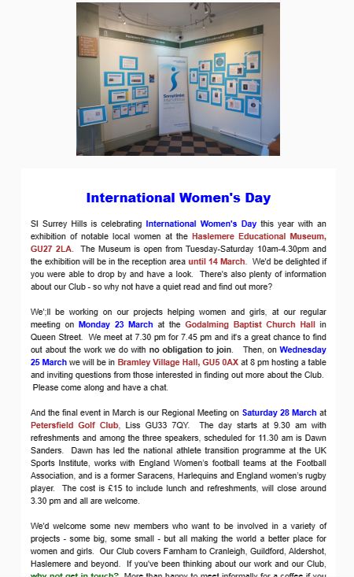
Newsletter (Mailchimp)

Slide 5
Local Magazines
Regular adverts in 'Round & About' and 'Vantage Point'
Free diary entries included
Occasional full-page features about the Club
Effective for recruiting new members

Slide 6
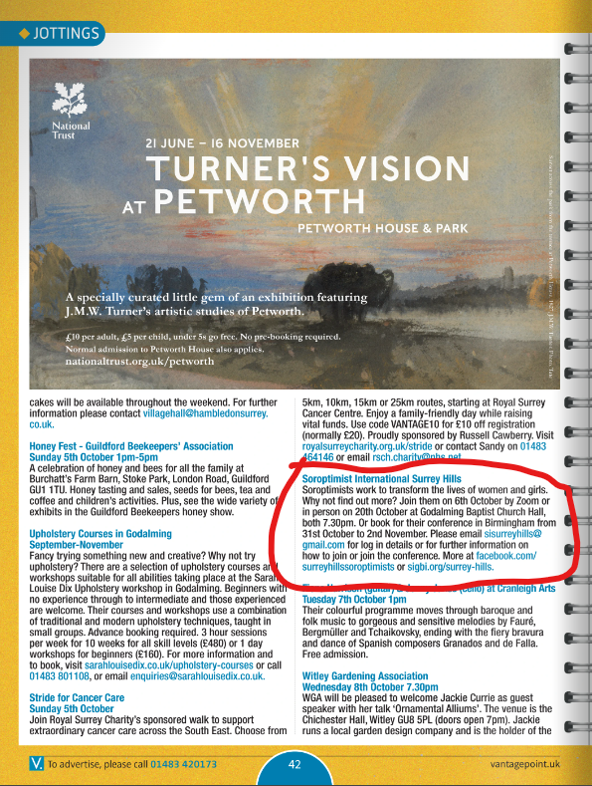

Local Magazines

Slide 7
Community Outreach
Bramley Showcase – an evening of societies showcasing their work
Talks to the WI, Townswomens Guild and others
Soroptimist International Surrey Hills We’re a friendly local group of women supporting women and girls. Join our meeting on Monday 23 March and learn about our projects at the Baptist Church Hall, Queen Street, Godalming (7.30 pm for 7.45 pm). Chat to us at the Bramley Village Showcase on Wednesday 25th March at 8 pm in the Bramley Village Hall. Finally, it’s our Regional Meeting on Saturday 28 March at Petersfield Golf Club, GU33 7QY with speaker Dawn Sanders, former England women’s rugby player. Further details on any of these meetings, please email sisurreyhills@gmail.com.

Slide 8
Impact on membership
Membership has increased by 31% in the last 12 months
Community engagement has increased
Soroptimists are much better known particularly in Godalming and Haslemere

