Slide 1

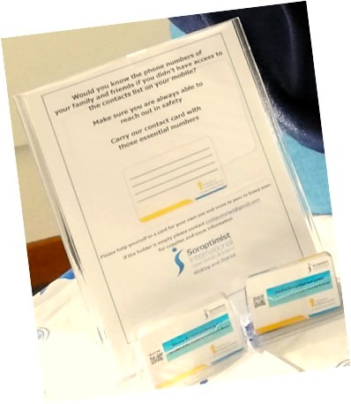
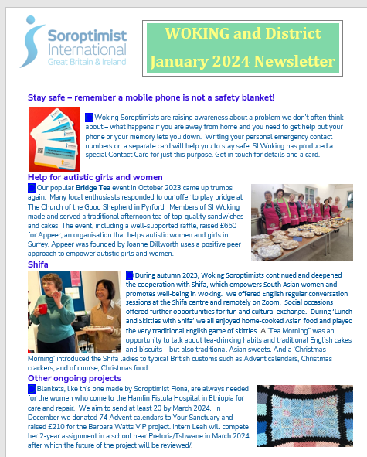




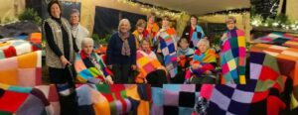
Visible communication in the community
Sustained, regular news – members, contacts…
Live: everyone, as much as possible
Notes:
Woking and District Presentation for Southern Regional Meeting March 2026
Woking and District have not undertaken any new project in the time frame identified. However, we wouldn’t want Region to imagine that we have done nothing! For instance, the safety card initiative presented a couple of years ago has been maintained and expanded with new stands purchased, so the cards can be presented attractively in libraries, cafes, hairdressers – almost everywhere! They are indeed an excellent introduction to the Soroptimist name, as well as communicating important information.
We maintain regular communication about our activities using our website, social media and twice-yearly newsletters, targeting members and the public.
However, amidst the general enthusiasm for digital communication, today we want to emphasise the importance of direct communication with real people.
For example, the local Woking Radio station recently provided an opportunity to speak directly to listeners about Soroptimists and our Club.
Our members have connections with a wide range of family members, friends and organisations. Encouraging all members to talk at every opportunity about what they have experienced in the Club, and what the Club is doing, can produce gratifying results: In addition to new members coming forward, we have examples of benefiting charities indirectly.
A representative of Woking Street Angels spoke at our Social Meeting a short time ago. They are volunteers who patrol the streets between the hours of 10pm and 4am to help people in difficulty. They are unpaid but the bag of items they carry with them costs £300 to buy, stock and replenish. Subsequently, one of our members suggested to her golf club that the charity would be a worthy recipient of a donation. The result? £1,000 was recently donated to Woking Street Angels.
And we don’t forget the importance of talking about what we do to our Friendship Links – a source of inspiration in both directions. I have personal experience of this: I joined SI Woking six years ago, having left SI Stourbridge in Midland Region. That region has knitted blankets for a fistula hospital in Ethiopia for the last 20 years….and knitting blankets has now become an SI Woking activity. Following which, thanks to our newsletter, SI Durham is also sending blankets to the Hamlin Fistula Hospital.
In conclusion, we are keen to use social media etc to publicise events and news items, but our experience tells us that the personal interactive touch - spreading the word - should still be considered one of the great Soroptimist strengths.
Thank you

