Slide 1
2021 - Our Centenary Year and my Regional Presidency Year
My Theme:
“Celebrate the Past, Create the Future”
Notes:
I am delighted it is our Centenary Year and delighted and humbled to be Regional President during it.

Slide 2
Our Centenary
Notes:
A Centenary sounds important but what does it really mean?
I decided to look it up
- and found what you might expect ...
It’s – “A Commemoration or celebration of an event that occurred 100 years ago”
an opportunity to celebrate – something which is pretty important in these challenging times.
The important event is the founding of Soroptimisit International – about which I will tell you more shortly

Slide 3
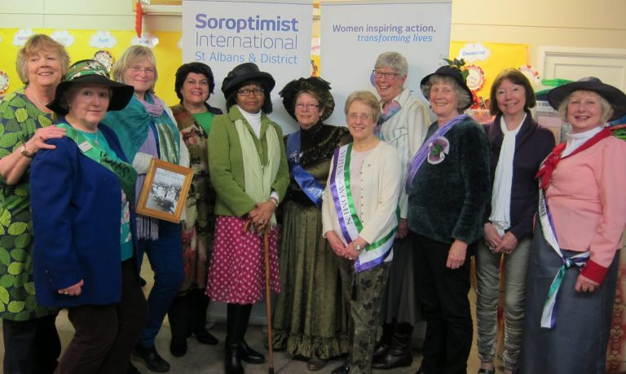
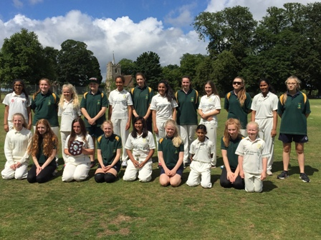
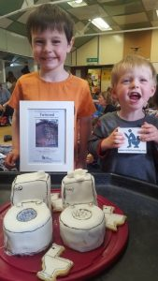
Centenary is a remembrance of substantial achievements.

Slide 4
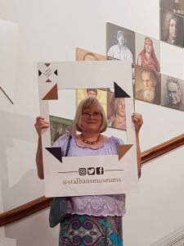
A hundred years in existence is a significant achievement in itself.

Slide 5
The past also has an impact on us today, in terms of how we react to it, interpret it, learn lessons, and apply it to now.

Slide 6
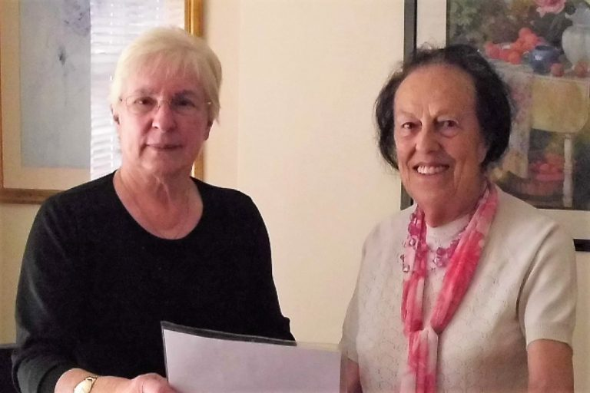
Commemorative activities are shaped by centenarians

Slide 7
Could we extend the conversation inside and outside the club?

Slide 8
A Centenary can be a spur to create a target
DIAMOND EDUCATION GRANT - £100 for 100
SI CENTENARY PROJECT - #PLANTTREES

Slide 9
A Centenary ……….. is an avenue for coming together, uniting and celebrating in oneness.

Slide 10
Making the Most of the Centenary at Region
Centenary Project #PlantTrees
100 for 100” #WhoIsShe campaign
Regional Centenary Celebration

Slide 11
Be inspired
SIGBI YEAR of CELEBRATIONS
SI YEAR OF CELEBRATIONS
a Reception at the House of Lords
a Birthday party at the Centenary Conference in Llandudno in 28 – 31 October
Commemorative items to buy – brooch, 1st Day covers & wine
https://sigbi.org/soroptimistcentenary2021/
A year of SI Voices - Podcasts and webinairs
A Weekend Online Conference in October 2021
https://www.soroptimistinternational.org/podcasts/

Slide 12
Our Club
1. Honouring the foundation of SI
2. Remembrance of substantial achievements
3. Hundred years in existence
4. Centenary as a time to reflect
5. Celebrate Centenarians
6. Taking our Centenary conversation outside ...
7. Centenary Target
8. Centenary Celebration

Slide 13
Thank you for listening

