Slide 1
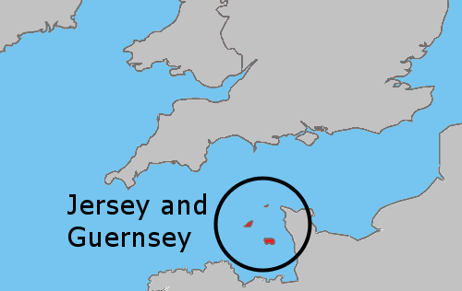
Potential transfer of CI clubs

Slide 2
The Issue
It often takes members from Guernsey and Jersey clubs a 3-day visit to attend the regional meeting of South West & Channel Islands, flying in via Exeter or Bristol, and thence to Taunton.
This might be so much easier, and achievable in one day, if they were to transfer to Southern England region, flying to the mainland via Southampton or even Bournemouth airport.

Slide 3
The Initial Plan
Step One
Confirm both CI clubs are happy to consider a move
Step Two
Define the travel pool arrangements and present them
Step Three
Invite CI clubs to Southern England regional meetings:
Step Four
Confirm both CI clubs are happy to proceed
Step Five
Attend SW&CI regional AGM on 11 July
Step Six
Confirm both regions are content
28 March, SI Winchester
13 June, SI Solent East
12 Sep, SI Weybridge
Step Seven
Draft a joint note to SIGBI Board to confirm the move and the name changes for the regions.
Transfer complete by Oct 2026

Slide 4
Progress update: dated June 2026
Step One complete is December 2025
Step Two (Travel Pool – definition & presentation) ongoing, as still to be agreed for our next regional year’s budget
Step Three in progress: invitation to our regional meetings
Step Four complete. Both Channel Islands clubs have confirmed they are happy to proceed, at their AGMs in April
Presentation slides updated for this SW&CI AGM in July
On track to make the move happen by conference, subject to agreement from us, South West region and SIGBI

Slide 5
Progress with The Plan
✅
Step One
Confirm both CI clubs are happy to consider a move
Step Two
Define the travel pool arrangements and present them
Step Three
Invite CI clubs to Southern England regional meetings:
Step Four
✅
Confirm both CI clubs are happy to proceed
Step Five
Attend SW&CI regional AGM on 11 July
Step Six
Confirm both regions are content
28 March, SI Winchester ✅
13 June, SI Solent East ✅
12 Sept, SI Weybridge
Step Seven
Draft a joint note to SIGBI Board to confirm the move and the name changes for the regions.
Transfer complete by Oct 2026

Slide 6
Action points:
Does South West & Channel Islands region agree to SI Guernsey and SI Jersey transferring to Southern England region?
Can SW&CI region nominate someone from their RMT to work with me on the SIGBI paperwork to make this happen?
Thank You.

